Slide 1
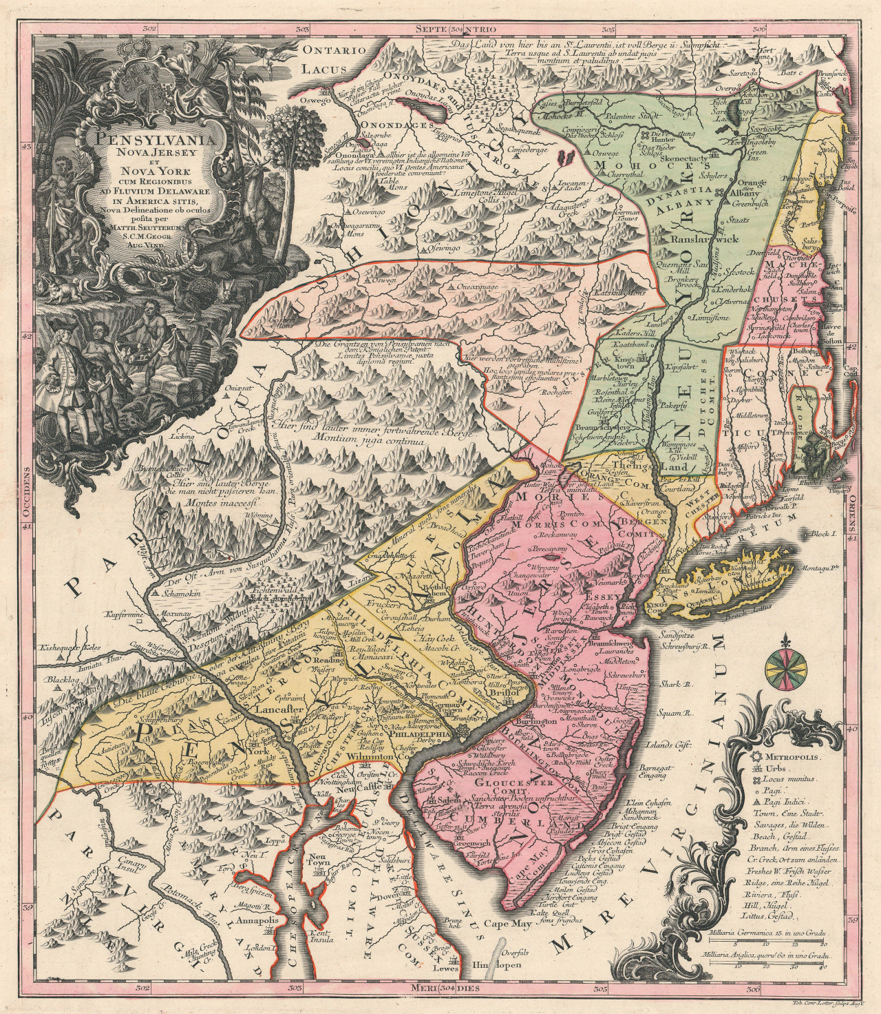
Early Colonization
Part 8
Mid Atlantic Colonies Continue

Slide 2
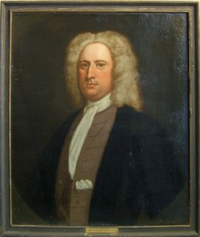
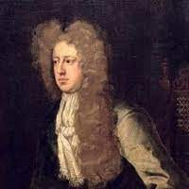
The Duke of York became the largest single landowner in America. He gave some of his land to his friends Sir George Carteret and Lord John Berkeley.

Slide 3
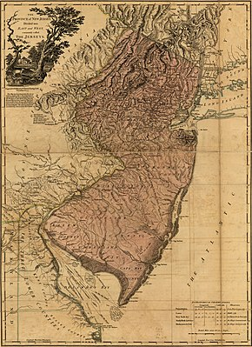
Carteret and Berkeley started the colony of New Jersey named after the island of Jersey in the English Channel.

Slide 4
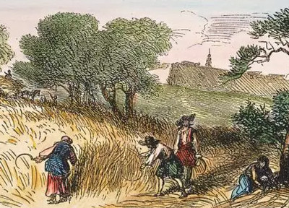
Berkeley and Carteret sold the land at low prices and allowed the settlers to have political and religious freedom. As a result, New Jersey was more ethnically diverse than many other colonies.

Slide 5
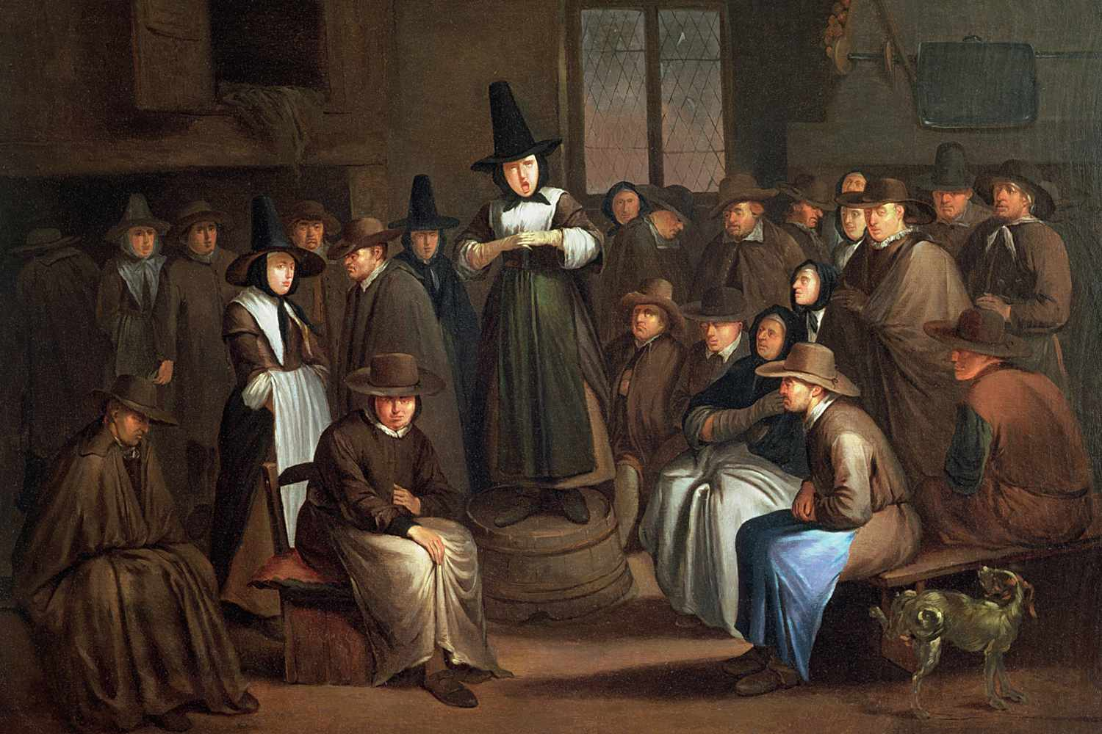
Back in England, another religious group that was opposed to the Church of England was the Religious Society of Friends, known as Quakers.

Slide 6
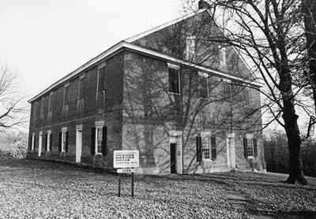
Quakers believed in living simple
lives. They believed in peace and
treating others fairly. They also
thought all people were created equal.
Quaker Meeting House

Slide 7
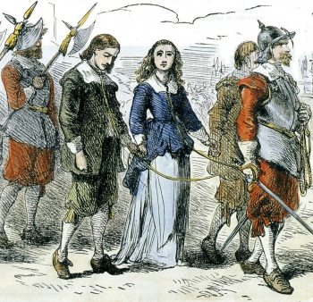
Quakers often got in trouble and went to jail because they didn’t attend the Church of England or take their hats off for the king.

Slide 8
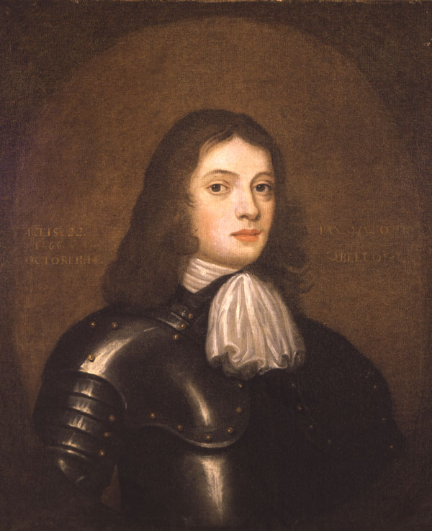
William Penn, the son of a famous Navy admiral, became a Quaker when he was 23 years old.

Slide 9
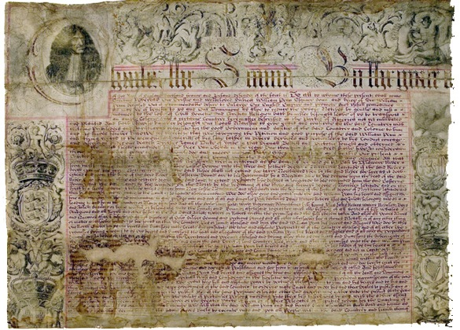
When William Penn’s father died,
King Charles II owed him money.
So to pay off the debt, the king gave William land in America.
This was called the Charter of 1681.

Slide 10
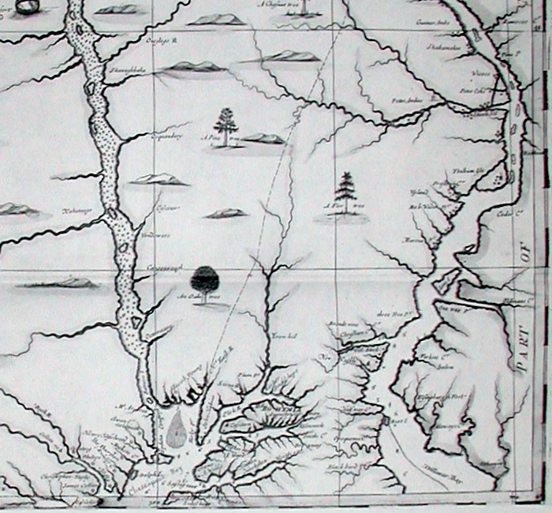
Penn wanted to name the new colony “Sylvania” which means “woods.” The king wanted William to name it after his father.

Slide 11
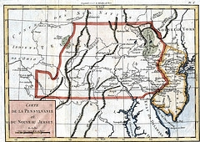
They compromised and called it “Pennsylvania.”

Slide 12
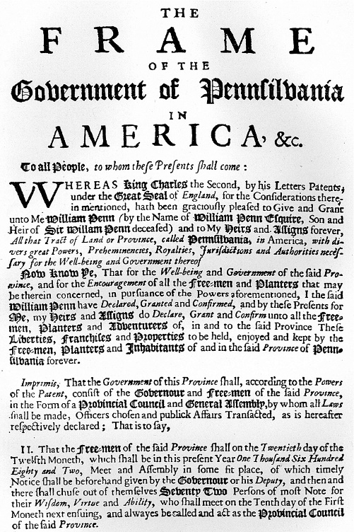
In 1682, Penn wrote Pennsylvania’s first constitution called the First Frame of Government. It made sure that everyone had freedom of religion.

Slide 13
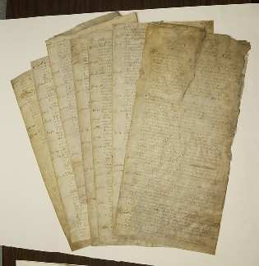
Penn also created the Great Law, which made sure that the people of Pennsylvania had a voice in their government.

Slide 14
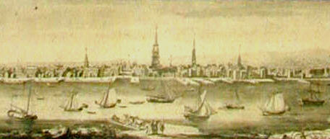
Penn started the city of Philadelphia, which means “City of Brotherly Love.”

Slide 15
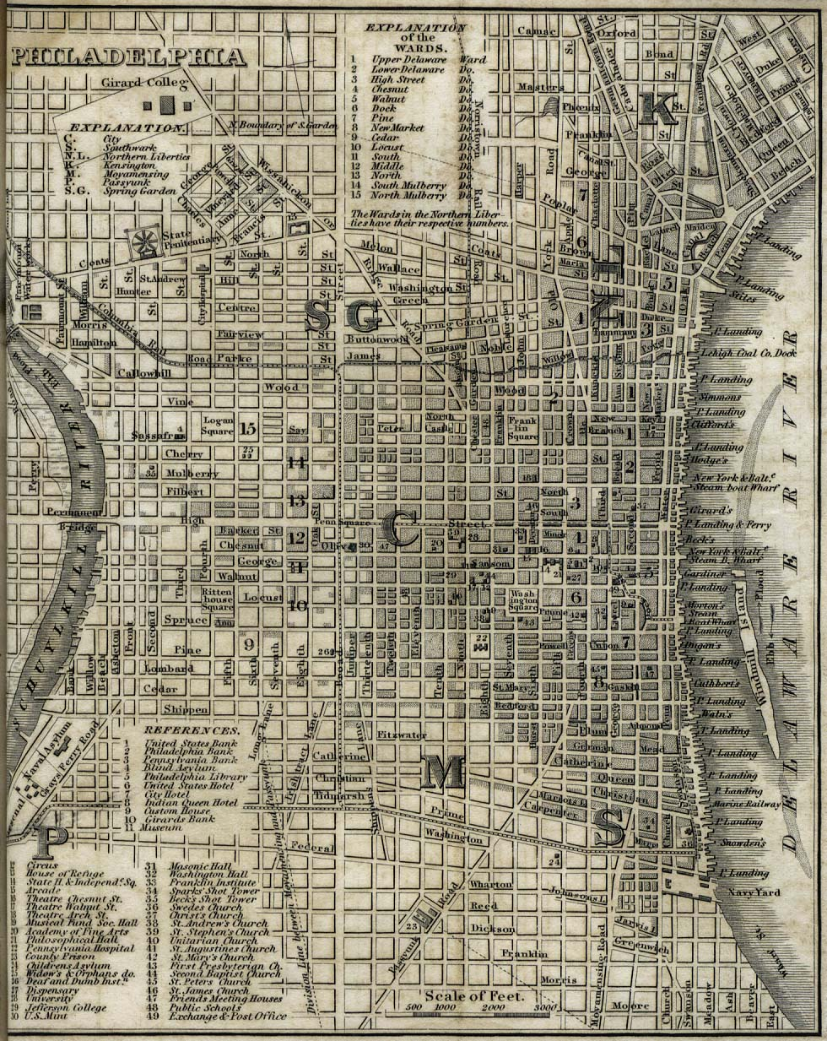
He designed Philadelphia to have straight streets and parks and public squares.

Slide 16
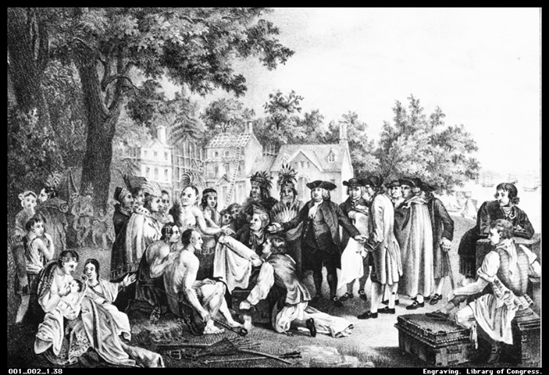
Penn treated the Native Americans living in Pennsylvania fairly. He wanted to be friends with them, and they respected him for that.

Slide 17
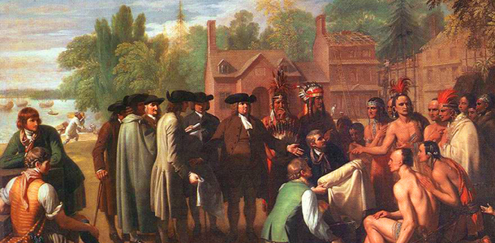
Penn and the Lenape signed the Treaty of Shackamaxon, in which Penn bought the land given to him by the king.

Slide 18
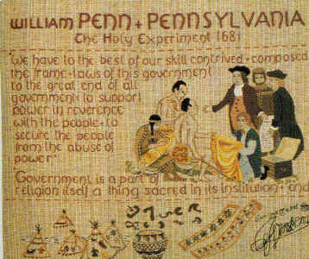
Penn called Pennsylvania a “holy experiment” because the colony was based on his Quaker beliefs.

Slide 19
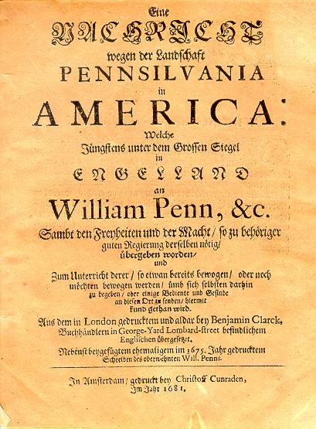
Penn wanted to treat everyone fairly in his new colony, so he sold land to people at good prices. He also invited people from different European countries to live in Pennsylvania.

Slide 20
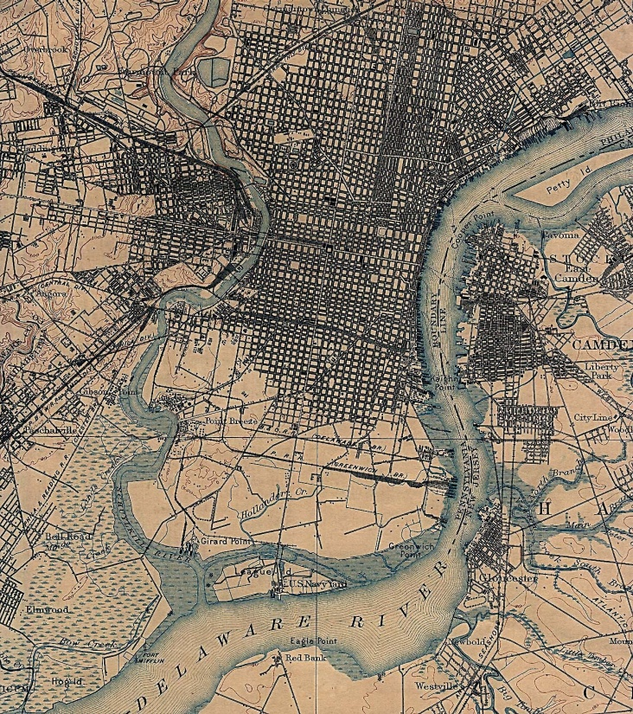
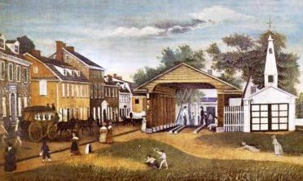
One group made up of 13 German families came to Pennsylvania in 1683 and settled near Philadelphia. They named their town Germantown.

Slide 21
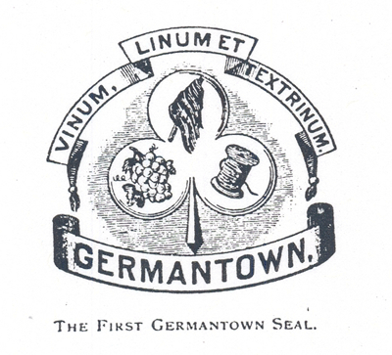
Many Germans would come and settle in the colony over the years. By the 1750s, more than ½ the population of Pennsylvania spoke German.

Slide 22
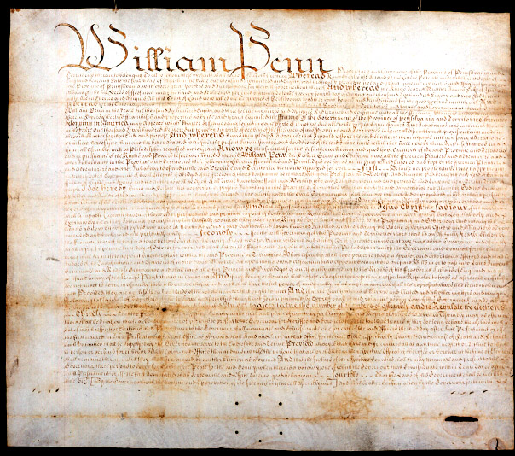
In 1701, Penn wrote the Charter of Privileges. It helped to give people more control over their government.

